Slide 1
Character-Centric Story Visualization via Visual Planning and Token Alignment
Chen et al., 2022
Paper presentation for Natural Language Processing course by
Auriane Mahfouz and Elena Zoppellari

Slide 2
Introduction
This paper proposes Character-Centric Story Visualization via Visual Planning (VP-CSV), a model that improves story visualization.
Previous works involve text-to-image generation and include:
GAN-based (Generative Adversarial Nets) models
DALL-E (Ramesh et al., 2021);
VQ-VAE-LM that combines VQ-VAE (Van Den Oord et al., 2017) with a text-to-visual-token transformer (Ramesh et al., 2021; Yan et al., 2021)

Slide 3
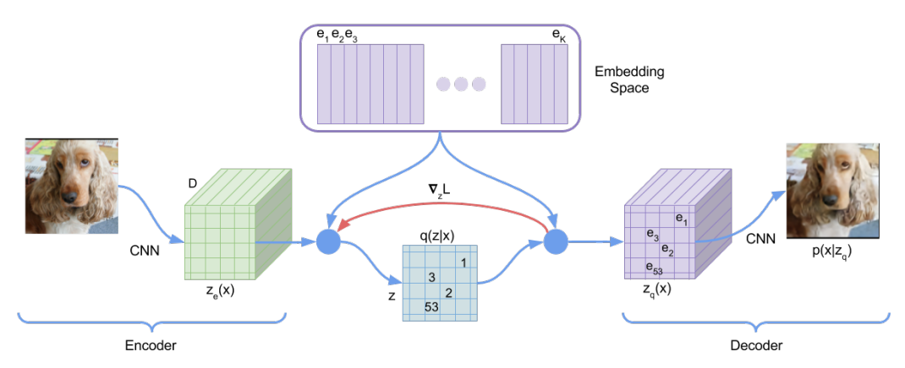

Vector Quantised Variational AutoEncoder
VQ-VAE encodes images into discrete latent representations.
Firstly, the images are encoded into continuous latent representations, then each of them is replaced with the closest embedding from the codebook.
In this way the discrete representations are built and then fed into the decoder.
1
1 image from Neural Discrete Representation Learning, van den Oord et al., 2018

Slide 4
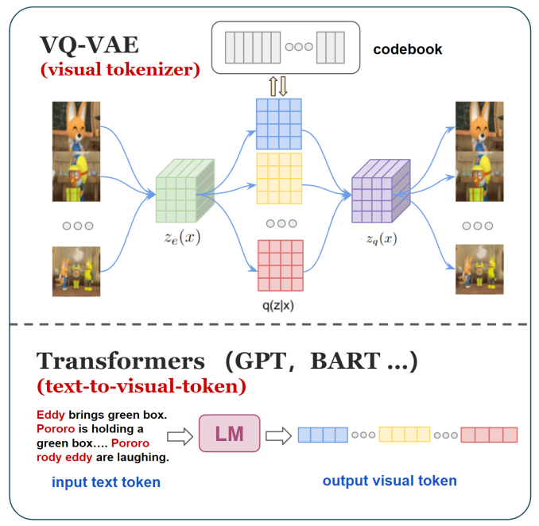
VQ-VAE integrated with Language Model: VQ-VAE-LM
As the first step, VQ-VAE is trained separately
LM takes input text sentences
LM is trained using MLE with the visual tokens from the VQ-VAE encoder as targets.
Visual tokens from LM are fed into the VQ-VAE decoder.
Images are reconstructed from the decoder.
The two models are trained from scratch by the authors.

Slide 5
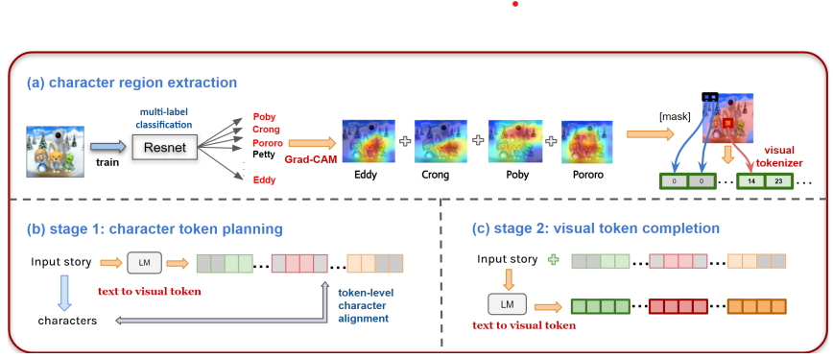
VP-CSV: Visual Planning based Character-centric Story Visualization
VP-CSV enhances VQ-VAE-LM with a two-stage module.
Character region extraction:
Train a multi-label classifier to identify the character regions
(b) Plan module:
Train GPT-2 to generate the planned character token prepared by the previous stage with a training loss of:
Lθ = − log p (r|s, θ)
(c) Completion module:
The model is trained to generate the background visual tokens z having a loss of Lθ = − log p(z|s, r, θ)

Slide 6
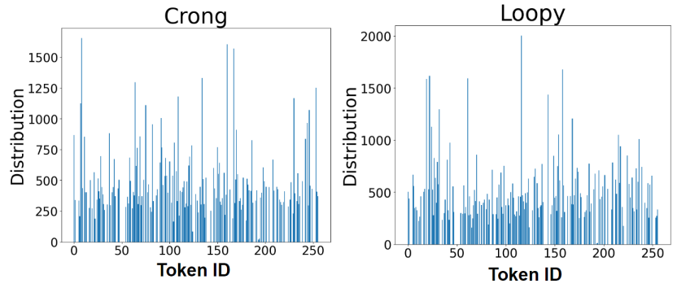

Token-level character alignment (TA)
The alignment process aims to match each character in the text with the corresponding visual token in the visual representation
compute the visual token distribution for each character
use a semantic loss to encourage the character-to-visual token alignment.
calculate the semantic loss as:
The intuition of this objective is that if all characters’ top visual tokens show up in the predicted images z (i.e. z |= Q), we increase the probability of tokens in P.

Slide 7
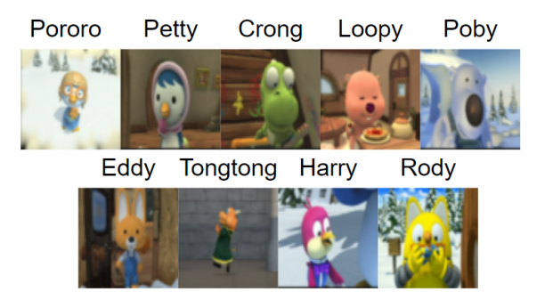
Experimental Setup
The story-visualization dataset is Pororo-SV
Each story is composed to 5 paragraphs
Each paragraph is associated with an image.
Evaluation
Character preservation
Character F1 score
Frame Accuracy (Exact Match)
Image quality
Frechet Inception Distance (FID)
Semantic alignment
BLEU score
R-precision
Human evaluation
Visual Quality
Character Preservation

Slide 8
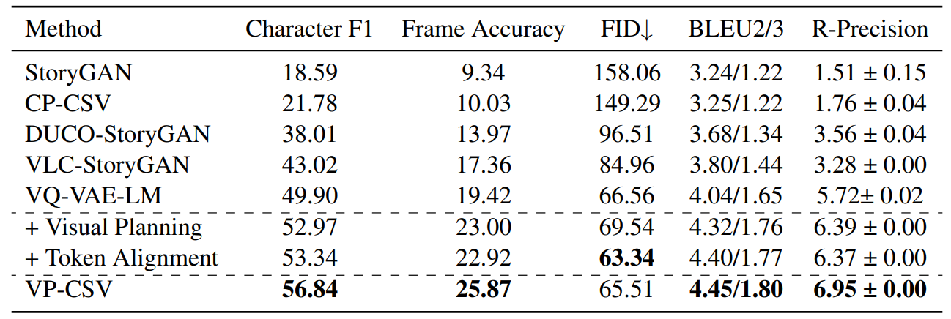
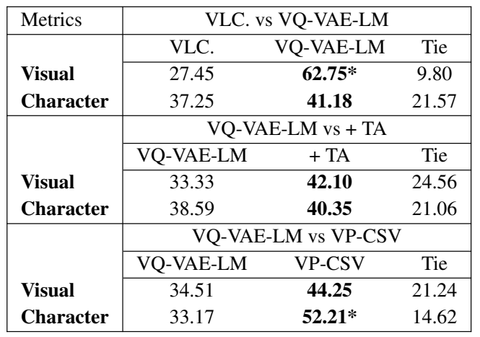
Results (I)
GAN-based models are outperformed by VQ-VAE-LM-based models
Adding Token Alignment to VQ-VAE-LM produces better Visual Quality than VQ-VAE-LM alone according both automatic metric and human evaluation
Overall VP-CSV model produces the best scores

Slide 9
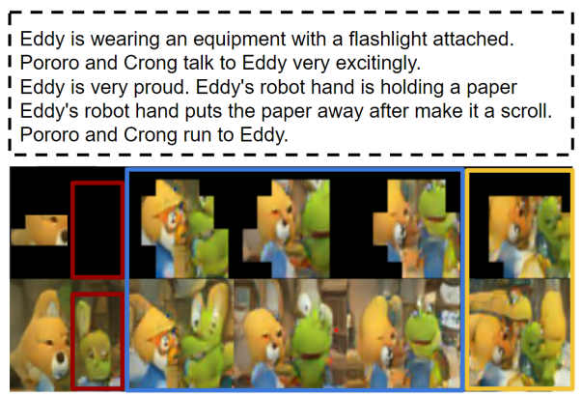
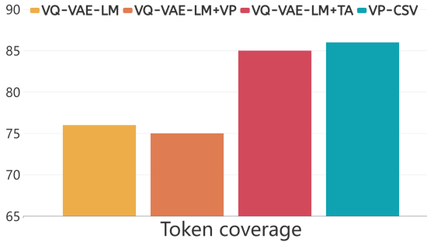
Results (II)
Analysis on visual planning
Blue square represents correct character identification with background masked
Red squares highlight errors of the completion module in generating non-existing characters
Orange square underlines poor image quality
Analysis on character alignment
Models with TA outperform the others

Slide 10
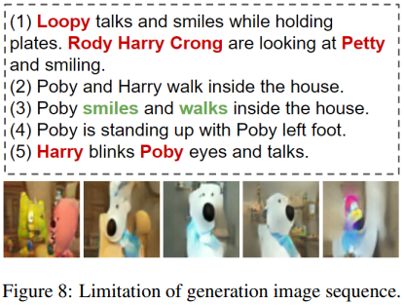
Conclusion
In this paper, visual planning and character token alignment was proposed to improve character preservation and visual quality.
Results show that the VP-CSV model outperforms all other models.
Future research can aim at integrating actions and relationships among characters.
LIMITATIONS
It is hard to generate every individual in the image.
The image quality is still low.
It is still hard to see the clear action performed by each character.

